Slide 1
Managing Body Composition
By Roberto Branco-Rhodes

Slide 2


Why is Body Composition Important?
Lower visceral fat (fat found in your abdominal cavity and around your belly) can help your body avoid diabetes (pronounced diabeetus) and heart disease.
Can greatly affect your performance in certain sports and activities (bodyweight training and gymnastics, track athletics, swimming etc.)
Lower body fat can greatly improve your facial structure!
Increasing muscle mass raises your BMR (Basal Metabolic Rate) so you burn more calories even when doing nothing!
Last but not least, who doesn’t want a toned physique for that summer holiday!

Slide 3
Factors that influence body composition
Macronutrient balance-
The three main macronutrients, Carbs, Proteins and Fats when consumed in different ratios and amounts have a heavy impact on your physique.
Daily caloric balance- (highly overrated, but still matters!)
Training Types-
Resistance training like weight lifting and calisthenics break down muscle fibres, elevate your testosterone and put your body into an anabolic (muscle fibre repair) state for hours after a workout is finished.
Anaerobic cardio such as HIIT (high intensity interval training) also break down muscle fibres and place your body in calorie burning state for hours after your workout, leading to more calories burned than traditional steady paced cardio.
Power based training such as sprints, plyometric and gymnastic style workouts stimulate fast twitch muscle fibres, improving speed, reaction time and again placing your body in an anaerobic and anabolic state for hours after your workout.
Eating frequency and quantity-
The basic principle of weight loss is such that if you eat more calories than you burn everyday, you will gain weight (most likely fat if you aren’t training).
Many of us eat way more than we actually realise!

Slide 4
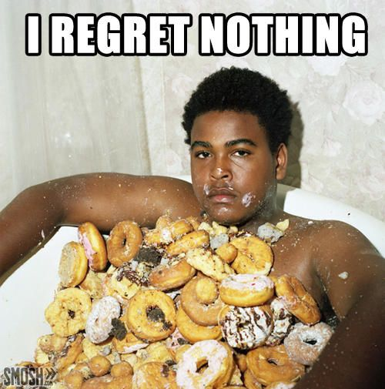
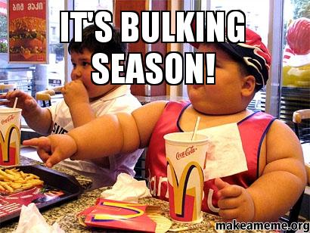
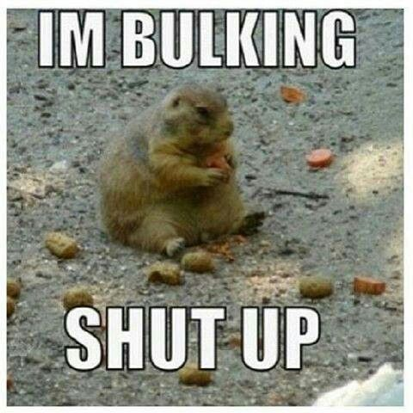
Dietary Myths
“It’s bulking season, time to eat pizza and wings f**k yeah”
“Don’t you get bored of your diet”
“Its just genetics”
“What protein do you take”
“I eat lots of fruit that’s healthy, right?”
“That’s really fatty and unhealthy”
“I can eat whatever I want within my calories”
“I went for a run today I earned that cheesecake”
“You must eat within 1 hour of your workout”
“Eating fat makes you fat (You are what you eat)”
“Must eat all tha proteiinnz hurr durr”
“Cholesterol will give me a heart attack”
“Don’t you get hungry at night?!?”

Slide 5
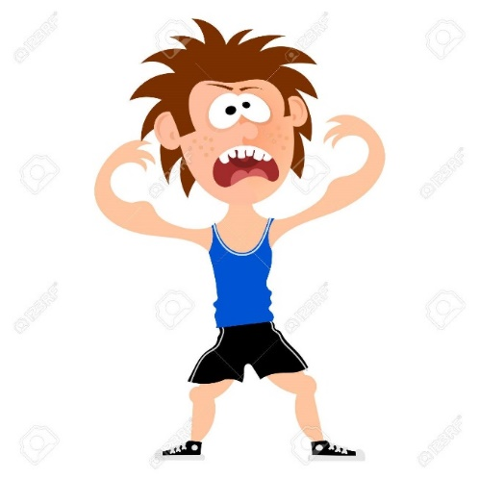
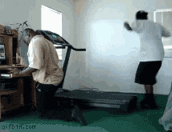
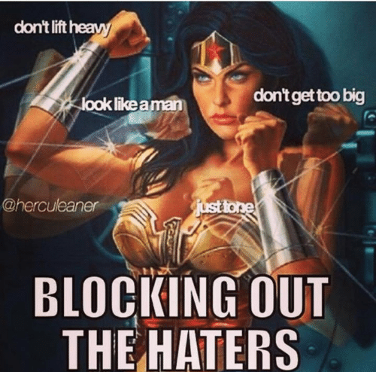
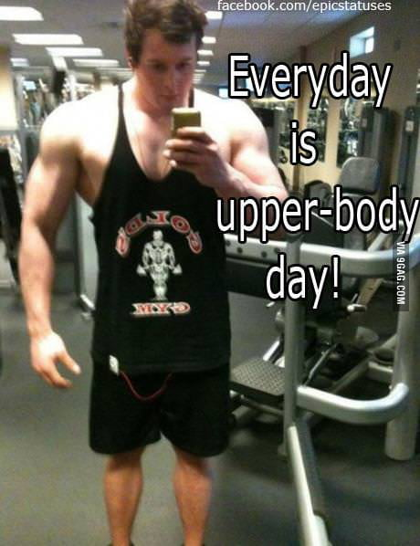
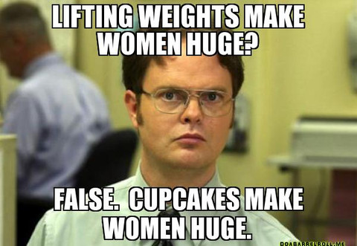
Training Myths
“I don’t want to get too big” – ladies I’m looking at you!
“Everyone is judging me”
“I’ve been training for years”
“But you were always athletic”
“you can only gain muscle lifting heavy”
“Everyday is upper body day”
“Everyday is leg day”- again looking at you ladies!
“I train abs everyday, why can I not see them?”

Slide 6
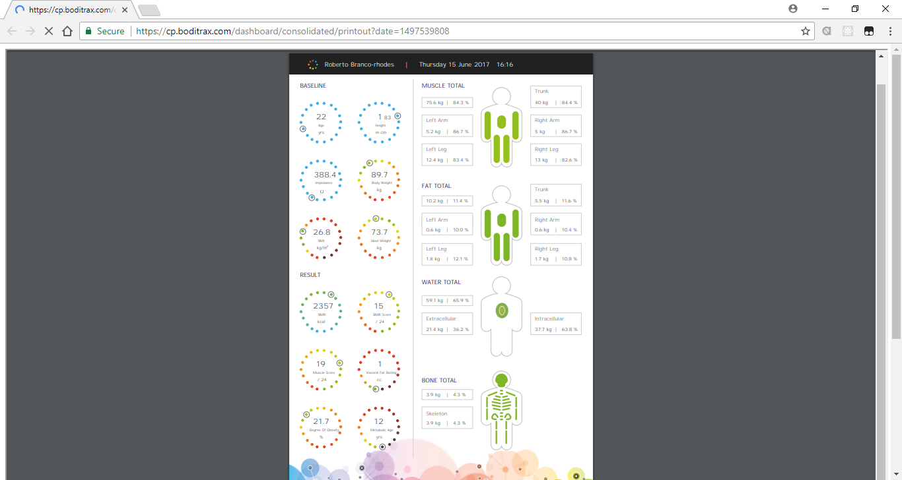
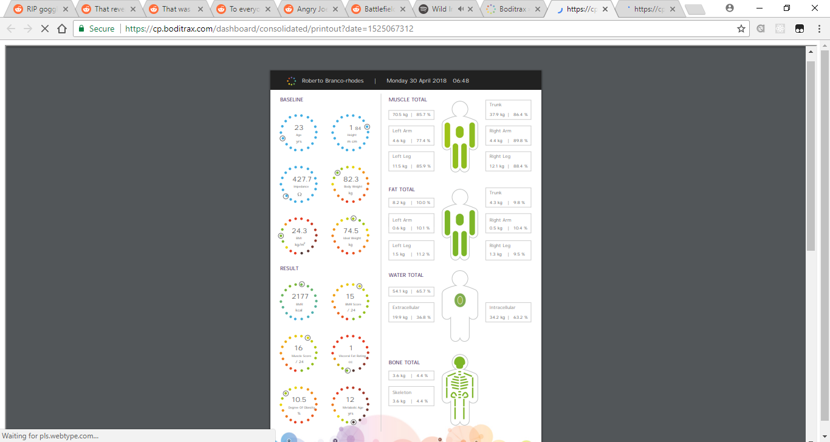
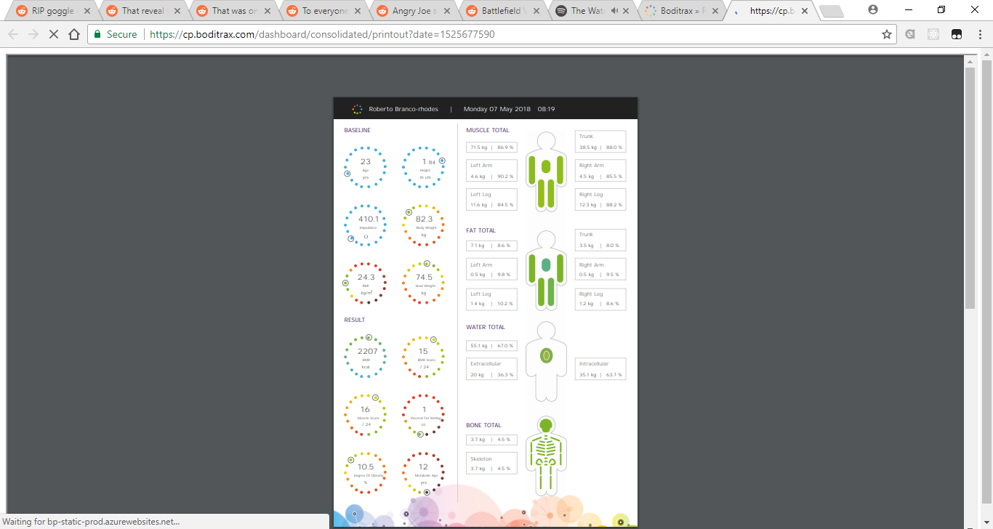
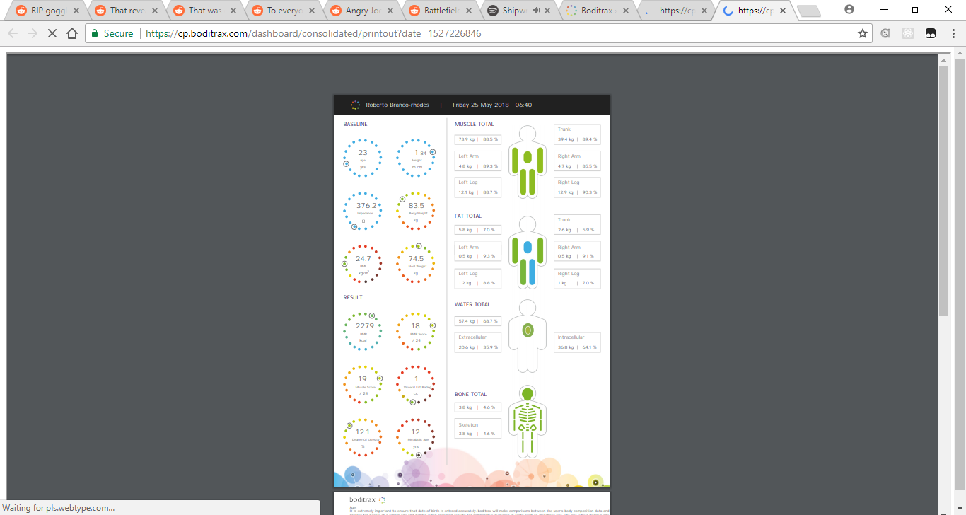
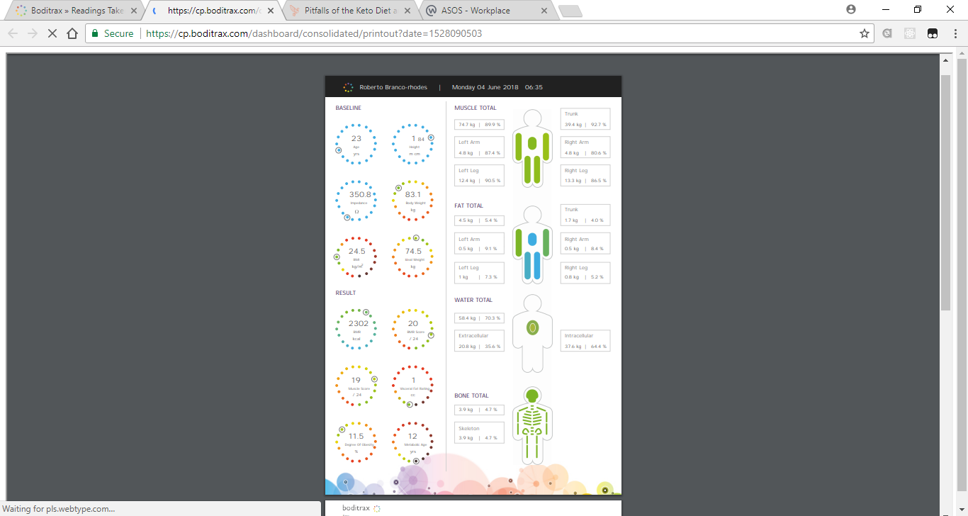
My Body Composition Changes
15th June 2017
30th April 2018
7th May 2018
25th May 2018
4th June 2018

Slide 7
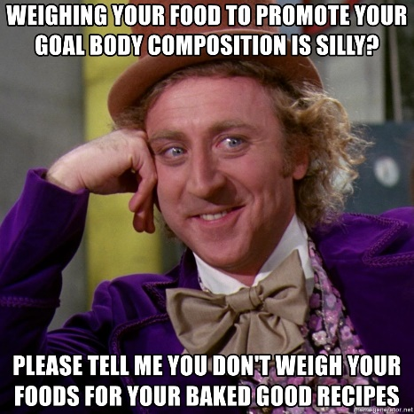
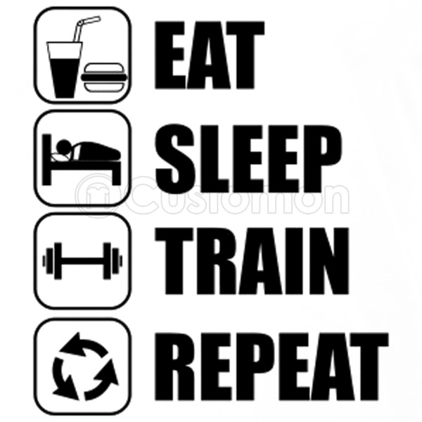
How I did it?
Followed a high-fat extremely low carb Ketogenic “Lifestyle”-
Forces the body to become fat adapted i.e. burning fats (both dietary and stored) over muscle tissue.
Lowers insulin (fat storage hormone) thus preventing fat storage and increasing fat mobilisation.
The breaking down of fat over glucose leads to the production of ketones (the body’s preferred energy source, especially the brain)
Prevents the body from storing unnecessary water weight, leading to the loss of unwanted body weight and bloating.
Lowers blood pressure and bad cholesterol (LDL) whilst increasing good cholesterol (HDL) used for hormone production
Fats are more satisfying than carbs so cravings are kept in check much easier.
The few carbs I do eat (leaves, berries, nuts) have all the micro nutrients and vitamins I need for health.
Due to the diuretic nature of the keto diet, be sure to consume a lot of water- I drink about 6 litres throughout the day to keep hydrated!
Wheat-based carbs are the enemy!
Intermittent fasting-
4 hours eating, 20 hours fasting daily
1 48 hour water fast a week, to cleanse the body of toxins and allow the body to heal itself more effectively.
Increases hormone production and testosterone, prolongs ketosis (fat burning mode)
Restricting your eating window leads to the consumption of fewer calories and the prevention of weight gain.
3 meals a day was never meant to be!
Consistent training
Bodyweight and core training everyday before work, weights for legs, 20min HIIT sprints 4 times a week, gymnastics after work occasionally.
Sleeping and resting when needed- when fatigued I would take a maximum of 1 day off during that week to recover.
I always get between 6 and 8 hours of sleep- very important!

Slide 8
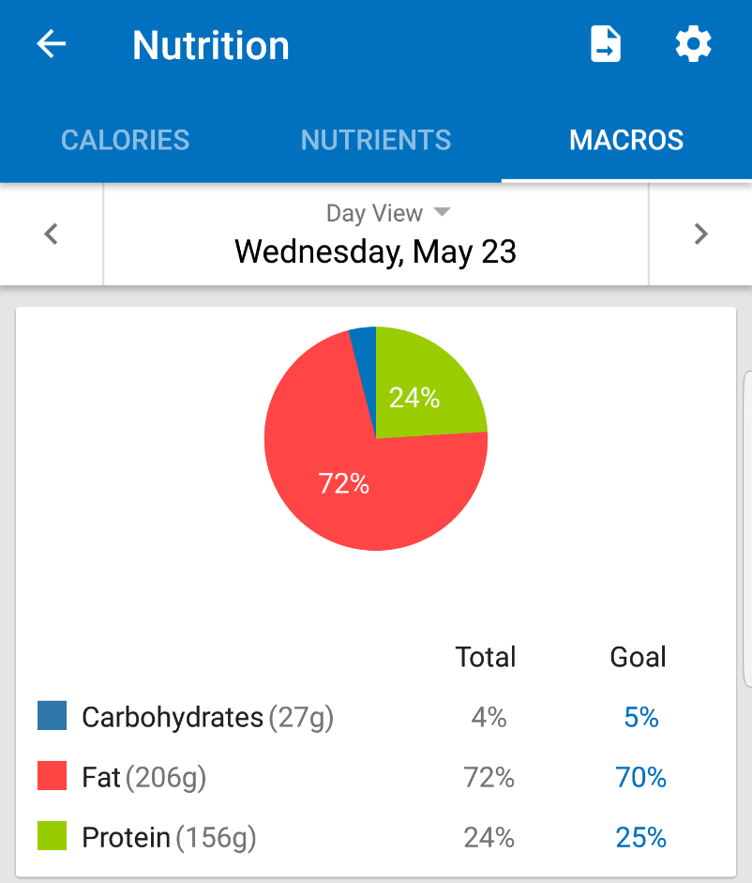
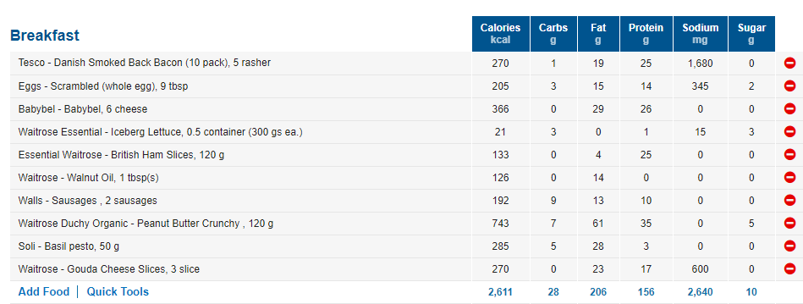
How I did it?

Slide 9
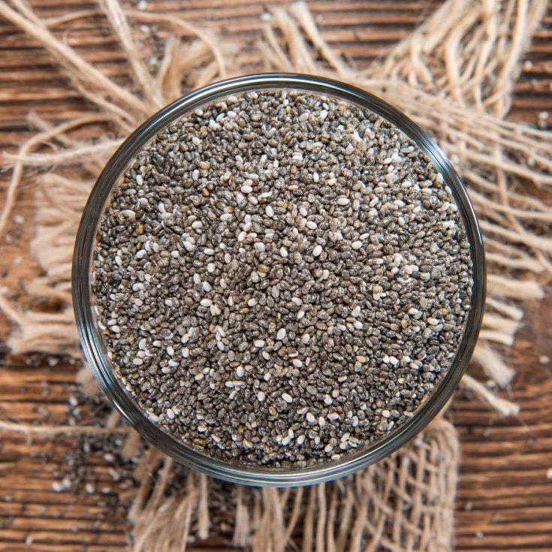
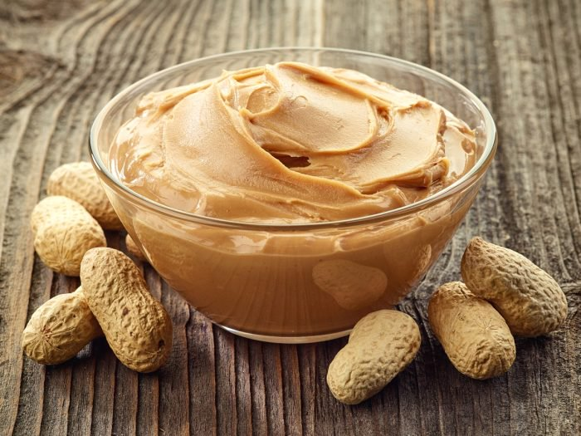
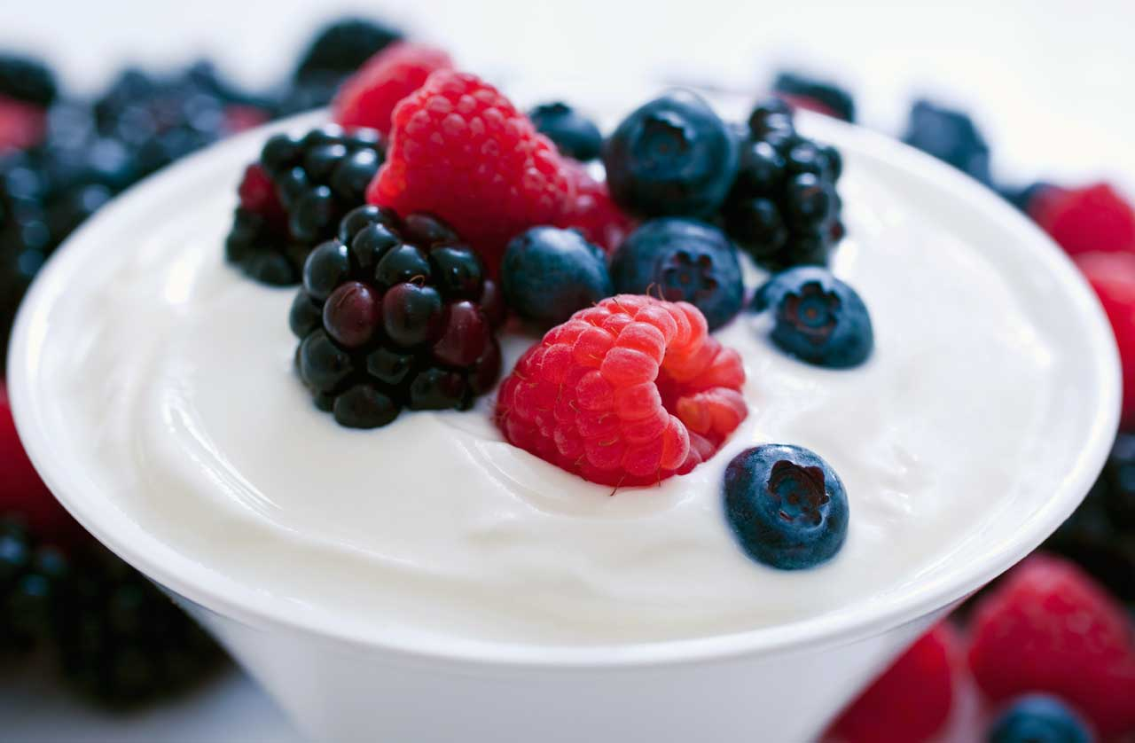

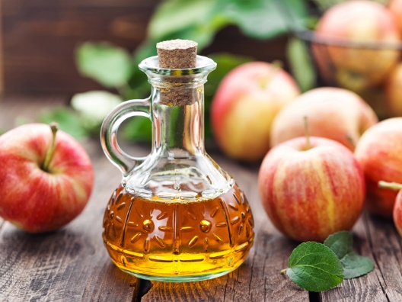
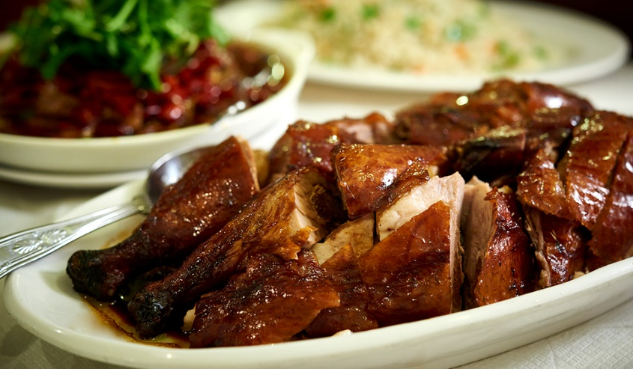
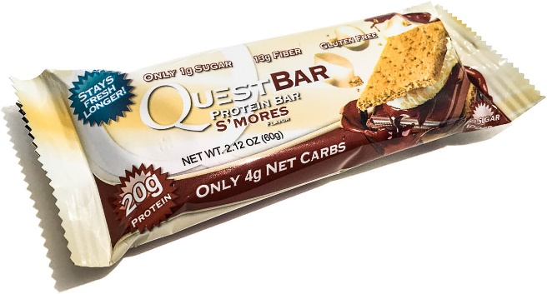
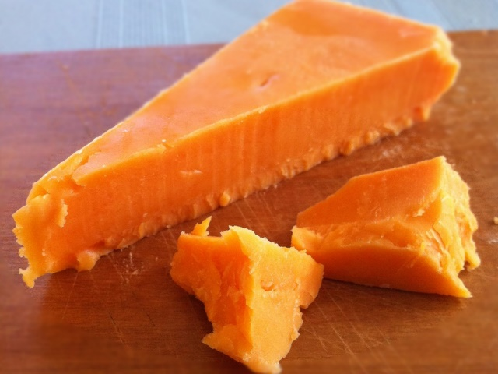
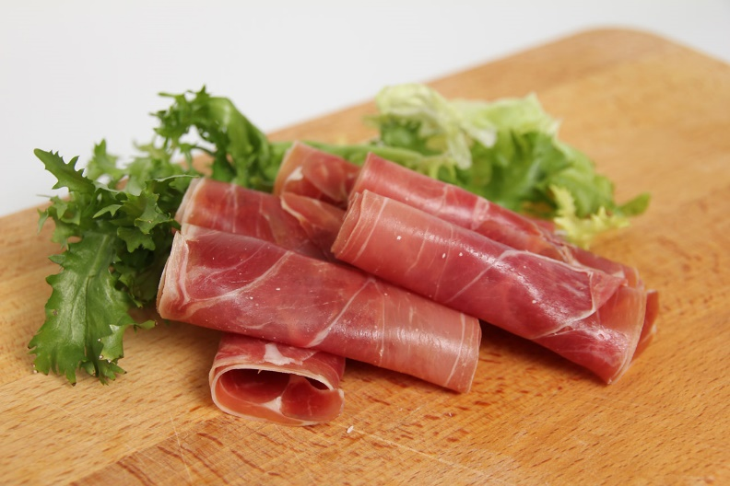
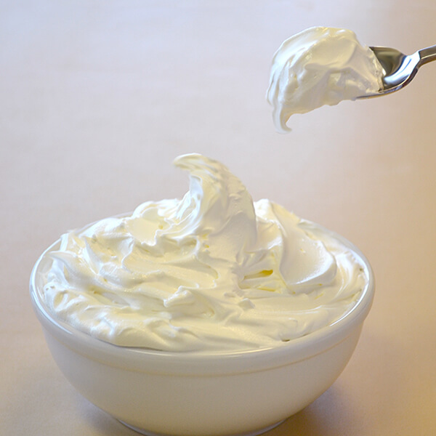
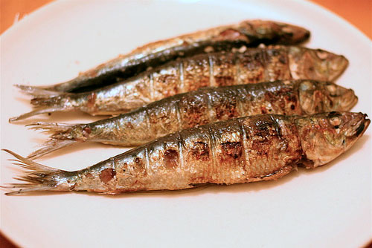

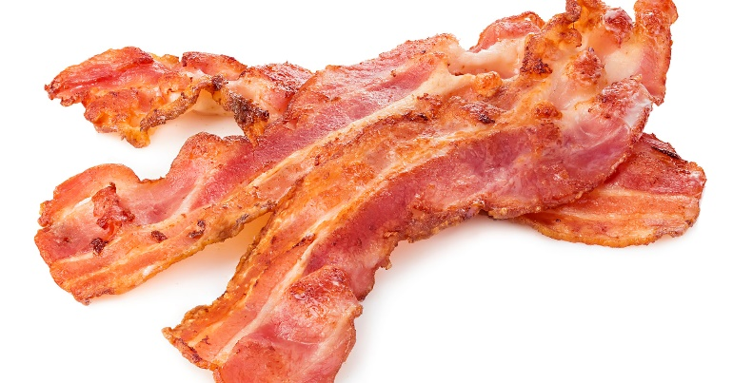
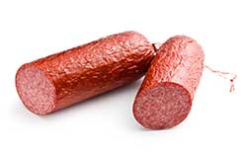

Slide 10
Key things to remember!
Only you know how much you can push yourself and commit.
Make lifestyle, not diet changes.
Make time not excuses!
Consistency is key.
The foundations for a successful summer body are built in the winter.
Make lifestyle changes, not “diets” or passing phases.
Results aren’t instant!
Build good habits! (15 day rule)

Slide 11
Helpful Links
https://www.reddit.com/r/keto/ - Keto diet Reddit forums
https://www.myfitnesspal.com/- MyFitnessPal calorie counter
https://www.ruled.me/keto-calculator/ -Calculate your ideal Keto intake
https://www.ruled.me/keto-recipes/ -Delicious Keto friendly recipes
https://www.youtube.com/channel/UCqjwF8rxRsotnojGl4gM0Zw - THENX Calisthenics tutorial channel
https://www.boditrax.com/ -Body composition tracker (normally found at virgin active gyms)
https://www.livestrong.com/ exercise and health tips
https://www.youtube.com/channel/UCe0TLA0EsQbE-MjuHXevj2A Athlean X - best no BS Youtube fitness channel
https://www.gymnasticbodies.com/forum Gymnastic tips and tricks discussion forums

Slide 12

The End

